Slide 1








FORECASTING CENTRAL BANK LIQUIDITY
July 7, 2022
Romain LAFARGUETTE, Ph.D., IMF MCM/CO

Slide 2
Overview
Forecasting infrastructure based on high-quality open-source codes
Forecast the three main autonomous factors separately and the net liquidity position
Using the most recent methods in the statistical literature
Easy to use for central banks: complex modeling issues are taken care of automatically
Open-source codes, free to use, up to the best programming standards
Provides automatic reporting and data visualization for daily operations
Team of experts to help the authorities during missions
Deploy the model and help the authorities to customize it and use it

Slide 3
Technical Assistance in Liquidity Forecasting
New standard for IMF Technical Assistance missions on central bank liquidity forecasting
Gain time to deploy top-notch infrastructure during TA missions, incl. documentation
“8-eyes” principles: 4 experts have thoroughly designed and tested thousands lines of codes
Leveraging on the experience gained over 10 TA missions (AE/EM/LIC) and more to come
Modular: the authorities can choose which item to forecast; we customize the infrastructure
We are here to help
Contact rlafarguette@imf.org or MCMCO-MGT@imf.org

Slide 4
The Team
Project Leader: Romain Lafarguette, Ph.D. (IMF-MCM, Eng/Fra/Chn)
ITD experts
Kei Moriya, Ph.D. (IMF-ITD, Eng)
Adeleke Adeyemi, Ph.D. (IMF-ITD, Eng)
External Experts
Prof. Anastasios Panagiotelis, Ph.D. (Univ. Sydney, Eng)
Prof. Nikolaos Kourentzes, Ph.D (Univ. Skovde, Eng)
Alain Quartier-La-Tente, Ph.D. (INSEE France, Eng/Fra/Esp)
… and more to come !
We also deliver general training in forecasting and programming during MCM TA

Slide 5
Refresher: Analytical Central Bank Balance Sheet
Assets
Liabilities
Net Foreign Assets
Domestic assets
Other assets net
Currrency in circulation
Securities issued by the central bank
Liabilities to deposit money banks (banks’ reserves)
Capital and revaluation account
(Claims – liabilities to non residents)
Claims on the government
Claims on deposit money banks
Other assets – other liabilities
Government deposits
In red: Autonomous Factors
In green: Policy Position
In blue: Other Items

Slide 6
Autonomous Factors and Policy Position
Autonomous
Factors
= Net Foreign Assets
Policy position
+/- Open market operations
+ Government position*
- Currency in circulation
+ Standing lending facilities & ELA
- Standing deposit facilities
Supply of banks’ reserves
*Government position: claims on the government – government deposits

Slide 7
Liquidity Forecasting and Management
Calibration of the regular, short-term OMO (Open Market Operations)
OMO to reach central bank optimal level/growth rate, based on the autonomous factors forecasts
Fine-tuning operations
Fine-tuning operations to smooth unexpected, unforecasted liquidity developments
Calibration of the required reserves with averaging
Banks use reserves averaging to smooth their liquidity during the reserves maintenance period
Calibrate required reserves to absorb the expected forecasting errors
Model-based approach to calibrate the different monetary policy instruments
Short-term: steer the domestic rate and fine-tune
Stable: long term instruments, market & yield curve development
Buffer: required reserves

Slide 8
Why Accurate Liquidity Forecasting is Important
Calibrate central bank operations accurately
Planify structural operations, calibrate the monetary policy instruments
Mitigate money markets volatility and strengthen financial stability
Improve monetary policy transmission
Support market development

Slide 9
Autonomous Factors Drivers
Autonomous Factors
Currency in circulation
Government Position
Net foreign assets
Other
Treasury cash-flow management (revenues and expenditures)
Transactional demand for banknotes/coins
Current and Capital Flows
Ad-hoc
Non-central bank borrowing from domestic and international markets
Dollarization/
De-dollarization

Slide 10
Institutional Arrangements to Improve Liquidity Forecasts
The Treasury should anticipate the government position based on the government expected cash flows and debt issuance schedule
Ease liquidity management and forecasting via Treasury Single Account
Memorandum of Understanding to share the information between the Treasury and the central bank
Gather information from important participants (liquidity contact group) and
Large companies with FX transactions (e.g. commodities importers/exporters)
Sovereign wealth fund, large money market funds, etc.

Slide 11
Publication and Transparency
The central bank should publish its liquidity forecasts
To help market participants to manage their liquidity
The central bank should also publish the forecasting methodology
Share technical capacity with the market
More transparency
Reinforce central bank credibility

Slide 12
Models Relevant for Each Driver
Autonomous Factors
Currency in circulation
Government Position
Net foreign assets
Other
Treasury forecast bias-corrected
Time-series seasonality model
Time series volatility model
Expert judgment/ad-hoc model
Forecasts Aggregation via Hierarchical Methods

Slide 13








Models Family
Seasonality
Smoothing
Use regression based methods
Capture regular and irregular seasonality
With new parsimonious approaches
Memory effect
Adjust quickly to structural changes
Models
Volatility
Combination
Deal with complex data
Model volatility as a separate process
Combine multiple approaches
State space, regression & smoothing
Can handle more complex patterns

Slide 14
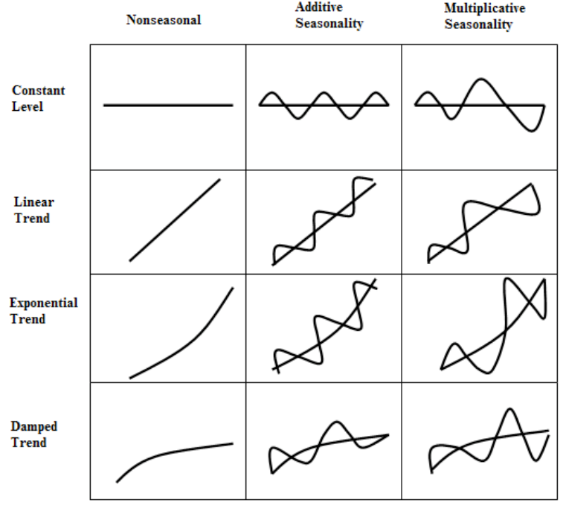
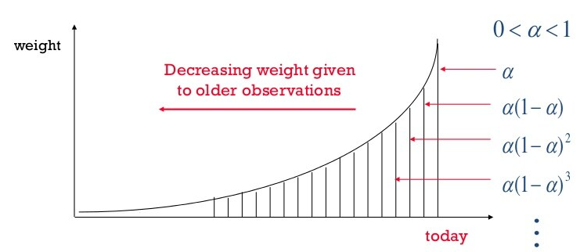
Exponential Smoothing

Slide 15
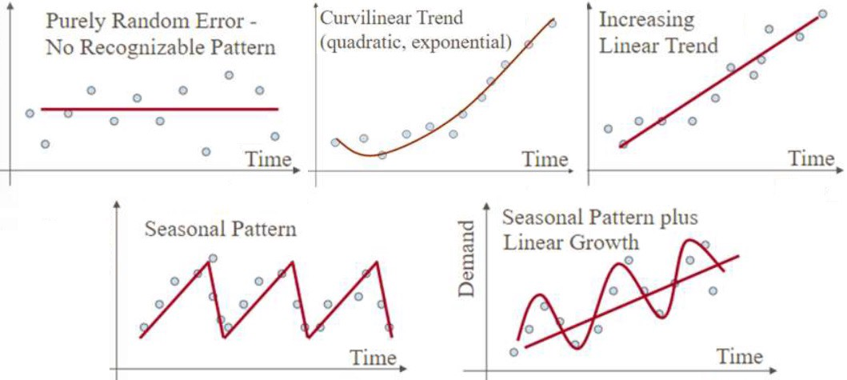
Time Series Patterns & Non-Stationarity Issues
Source: medium.com

Slide 16
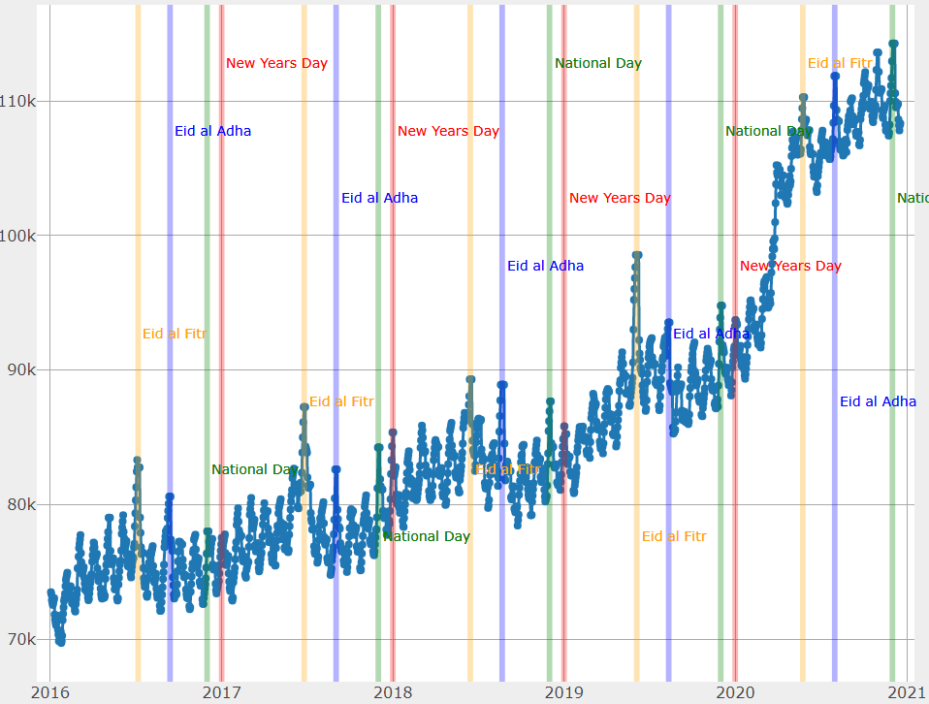
Seasonal Patterns in Practice

Slide 17
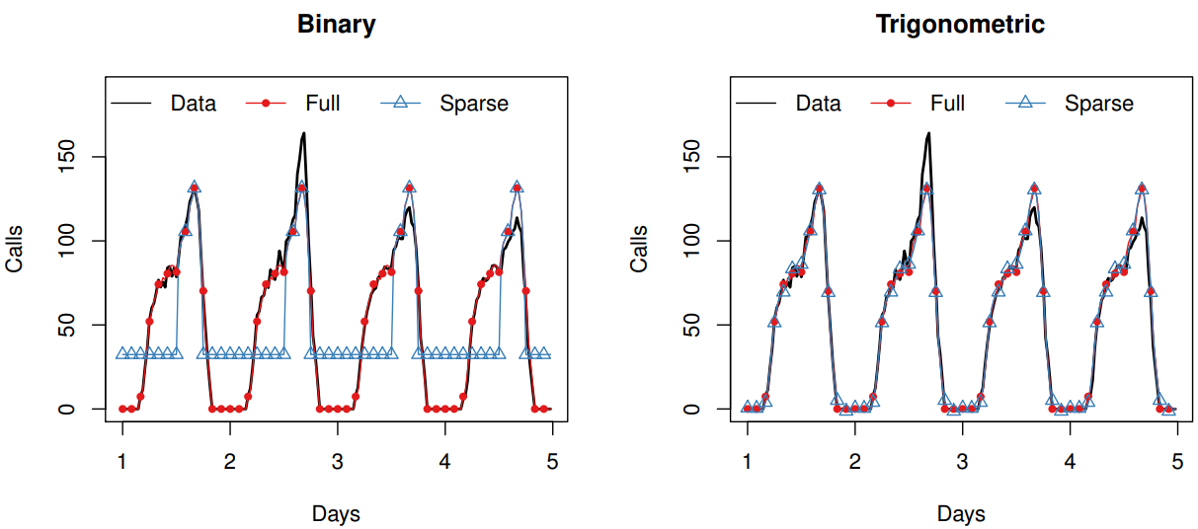
Modeling Seasonality
Binary tries to capture every single phenomenon
Trigonometric models a cycle : much more parsimonious

Slide 18




Statistical Trade-Offs
Data-driven decision
Features
Accurate models perform well in specific situations
Can underperform severely in other
Complexity
Capture a very particular, single, complex pattern
Accuracy
Performances
Robust models
perform reasonably well on average
Limited risk of underperformance
Flexibility
Capacity to handle different data patterns equally well
Rosbustness
Flexibility
Complexity

Slide 19



Models Selection
Leverage on Models Diversity to Reduce Modeling Risks
Single Models
Dynamic Selection
Model Averaging
Test each of them
Ranked by performance
Take the most recent best model
Adjust quickly to structural changes
Average the top 3 models
Reduce modeling risk

Slide 20
Empirical Strategy
Estimate all Models
Out-of-Sample Performance
How accurate each model is? What is the best model for each autonomous factor?
Forecast
Based on the best model, forecast
How each model exploits the information in the data?

Slide 21
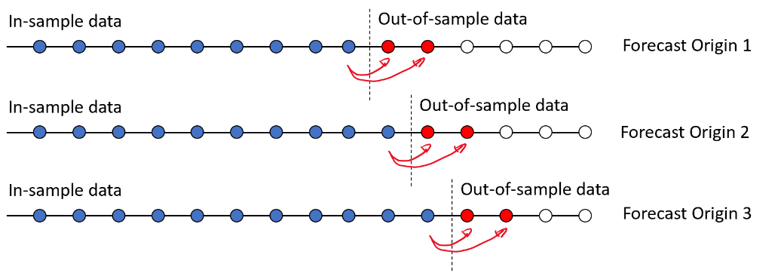
Out of Sample Performance: Concept
Source: alphascientist.com

Slide 22
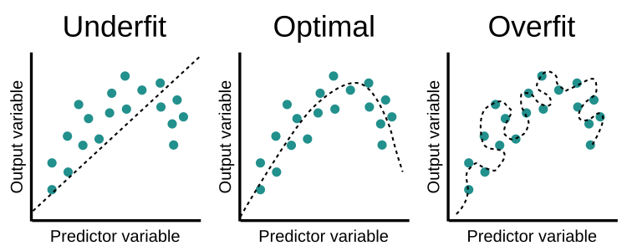
Under- and Over-Fit
Source: www.educative.io/

Slide 23
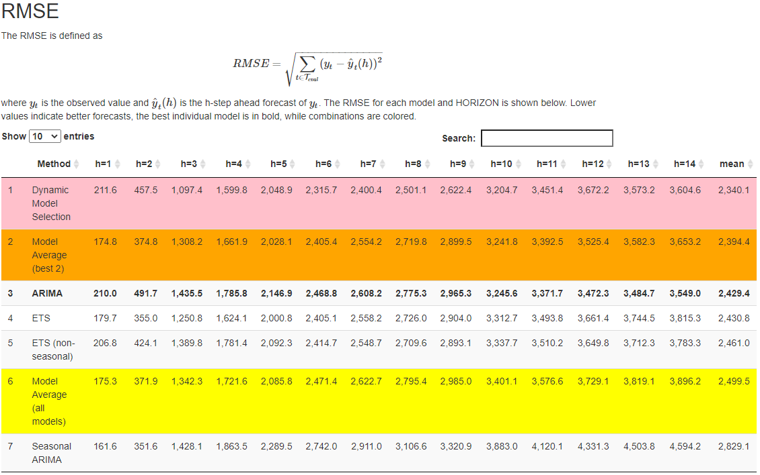
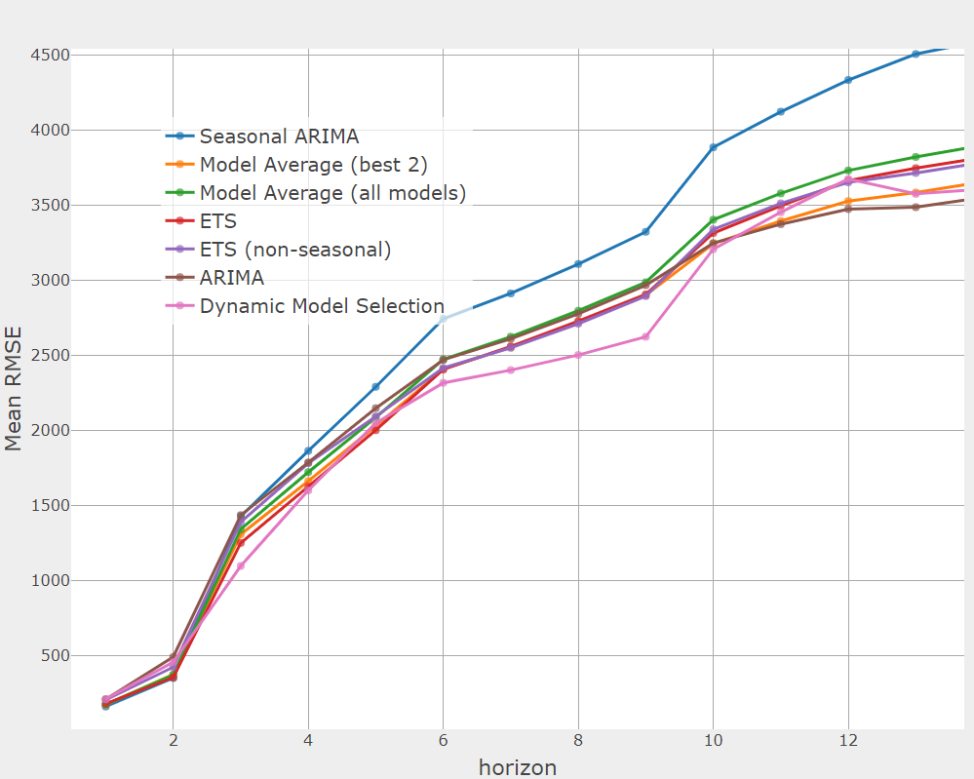
Out-of-Sample Output

Slide 24
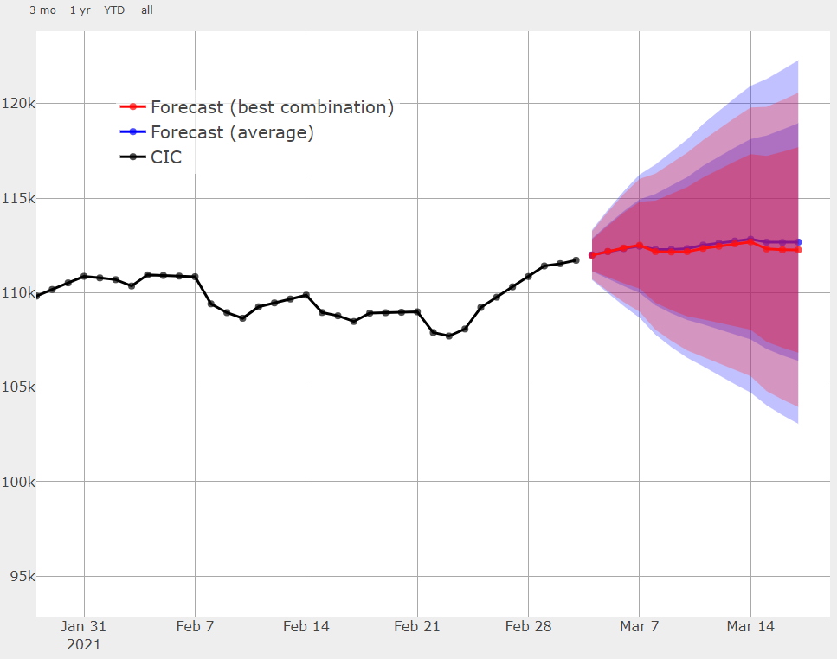
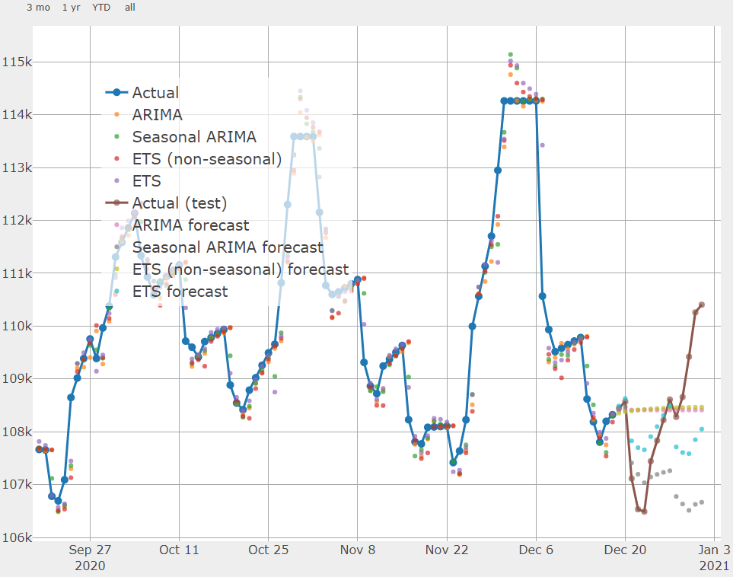
Forecasting Output

Slide 25
Software Infrastructure
R Codes
Input/Output
Data inputs
Config File
Framework
Validation File
Validation Reports
Forecast File
Forecasts Reports

Slide 26
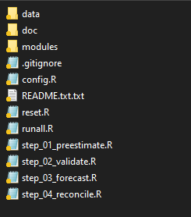
Forecasting Infrastructure in Practice

Slide 27
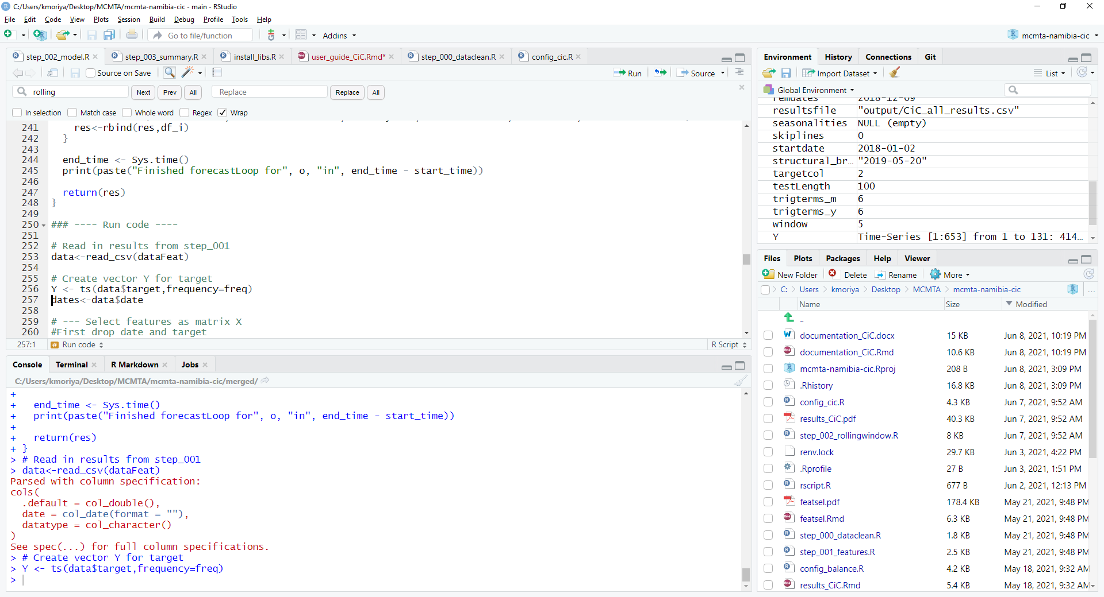
R Studio Interface (https://www.rstudio.com/ )

Slide 28



Operational Procedure
Data Feed
01
Every day update the data
Use an Excel template
Forecast
Every day, forecast the autonomous factors & total liquidity projections
Execute in a few seconds
Warnings for outdated validation
Validation
02
03
Once every quarter, or after structural break
Investigate models performance
Can take a few hours
Update config file

Slide 29
TA Questionnaire and Data Requests
Qualitative Questionnaire
Central bank framework, institutional arrangements, etc.
Data Requests
Daily data over the longest time frame possible
The data should be ready before the TA mission starts
The framework works for general time series forecasting, not only CB liquidity

Slide 30
Contributions
Forecast the three main autonomous factors with advanced models
Combine the autonomous factors forecasts into a single liquidity measure
Incorporate risk into liquidity forecasts
Use a robust modeling framework to deal with structural breaks and complex data samples
Automatic data reporting and data visualization
User-friendly interface based on an open-source and free statistical software (R)
Community of experts, working on public codes (Github)

Slide 31
Main References
Cabrero, Alberto, Gonzalo Camba-Mendez, Astrid Hirsh, and Fernando Nieto. 2002. “Modeling the Daily Banknotes in Circulation in the Context of Liquidity Management of the European Central Bank,” European Central Bank Working Paper No. 142, May.
Gray, Simon T. 2008. “Liquidity Forecasting,”, Bank of England, Centre for Central Banking Studies Handbook—No. 27, June.
Andrea Shaechter, 2000 “Liquidity Forecasting”, International Monetary Fund
Veyrune, Romain, Shaoyu Guo. 2019. “Autonomous Factor Forecast Quality: The Case of the Eurosystem”, IMF Working paper No. 19/296, December.
Anderson, D., & Burnham, K. (2004). Model selection and multi-model inference. 2nd ed. NY: Springer-Verlag.
Athanasopoulos, G., Hyndman, R. J., Kourentzes, N., & Petropoulos, F. (2017). Forecasting with temporal hierarchies. European Journal of Operational Research, 262(1), 60-74.
De Livera, A. M., Hyndman, R. J., & Snyder, R. D. (2011). Forecasting time series with complex seasonal patterns using exponential smoothing. Journal of the American statistical association, 106(496), 1513-1527.
Wickramasuriya, S. L., Athanasopoulos, G., & Hyndman, R. J. (2019). Optimal forecast reconciliation for hierarchical and grouped time series through trace minimization. Journal of the American Statistical Association, 114(526), 804-819.

Slide 32
Thank You Q&A
Website: http://www.afritacwest2.org Facebook: http://www.facebook.com/afritacwest2

Slide 33
Question 1
What are the benefits of accurate liquidity forecasting for central banks operations? Multiple answers possible:
Reduce inflation
Better calibrate the operations
Reduce the interbank interest rate volatility
Stabilize the exchange rate
Support the interbank market development

Slide 34
Question 2
Which strategy is valid to reduce the risk of being reliant of a single model (modeling risks)? Multiple answers possible:
Model averaging
Use large data sample
Remove outliers
Dynamic model selection
Complement the results with expert judgment

Slide 35
Question 3
What are the problems associated with using many binary variables to model seasonality? Multiple answers possible:
Complicated to estimate
Takes excessive computation time
Add parametric noise
Risk of overfit

Slide 36
Question 4
Why is it more appropriate to evaluate the performance of models out-of-sample rather than in-sample? Multiple answers possible:
Reduce the impact of outliers
Avoid structural breaks
Avoid overfitting
Test forecasting in real conditions

Slide 37
Question 5
Under which circumstances should you revalidate the forecasting models? Multiple answers possible:
A few weeks after a structural break
A long time (e.g., a quarter) after the last validation
After you observe a loss in forecasting accuracy

Slide 38
Appendix Slides

Slide 39
Baseline and Advanced Models
Baseline models include:
The random walk (naïve)
Seasonal random walk (seasonal naïve)
Exponential smoothing (ETS) with model selection
ARIMA with model selection.
Advanced models expand:
ETS and ARIMA to model the multiple periodicities that are present in the data
Treatment of structural breaks

Slide 40
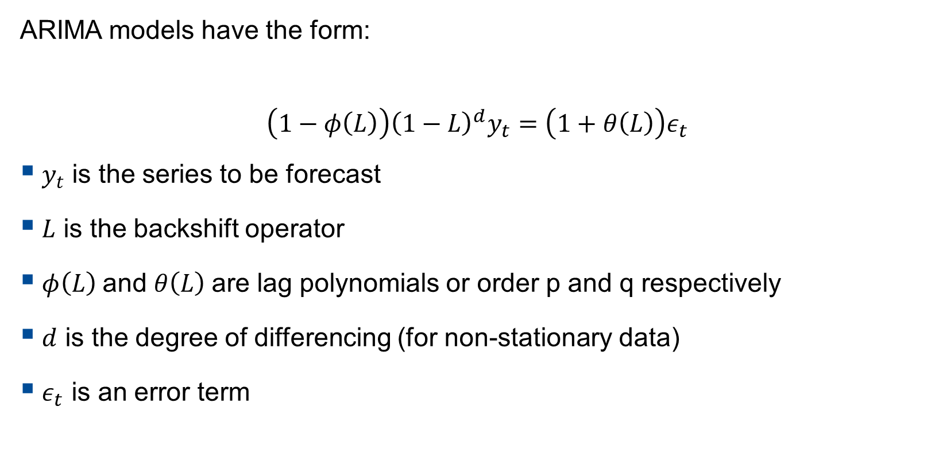
ARIMA Model
ARIMA models have the form:
$$\left(1−φ\left(L\right)\right){\left(1−L\right)}^{d}y_{t}=\left(1+θ\left(L\right)\right)ε_{t}$$
$y_{t}$ is the series to be forecast
$L$ is the backshift operator
$φ\left(L\right)$and $θ\left(L\right)$are lag polynomials or order p and q respectively
$d$ is the degree of differencing (for non-stationary data)
$ε_{t}$ is an error term

Slide 41
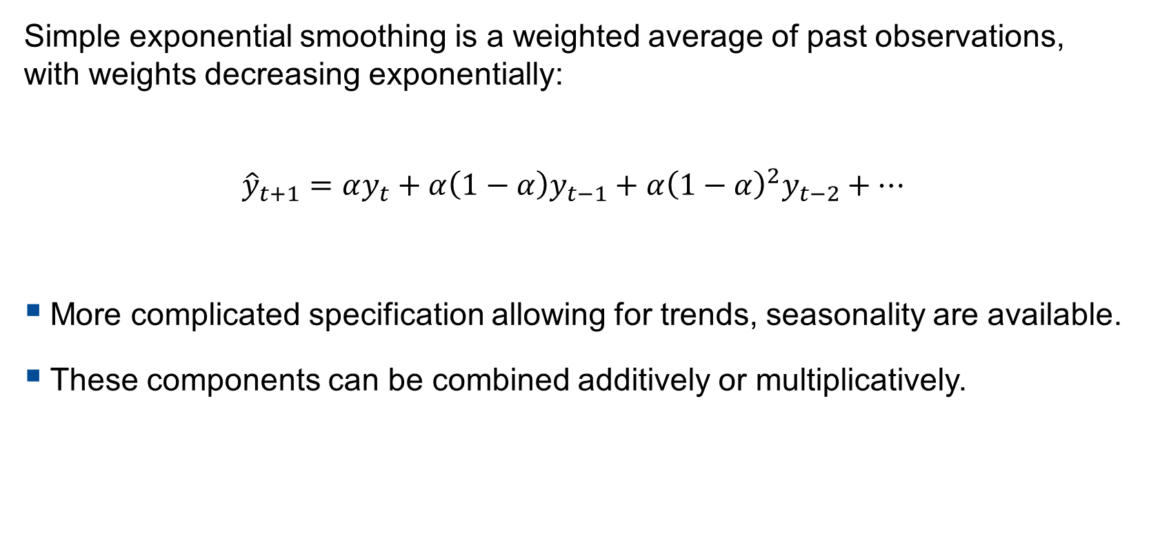
ETS Model
Simple exponential smoothing is a weighted average of past observations, with weights decreasing exponentially:
$${\hat{y}}_{t+1}=αy_{t}+α\left(1−α\right)y_{t−1}+α{\left(1−α\right)}^{2}y_{t−2}+…$$
More complicated specification allowing for trends, seasonality are available.
These components can be combined additively or multiplicatively.

Slide 42
Advanced Models: Typology
ETS with trigonometric multiple seasonalities and indicators for events.
ARIMA with trigonometric multiple seasonalities and indicators for events.
ARIMA with stochastic multiple seasonalities and indicators for events.
TBATS – a state space model with exponential smoothing, stochastic trigonometric patterns, Cox-Box transformation and ARIMA errors. TBATS cannot incorporate events.
Composite TBATS – where the local level and events are modelled with ETS and the seasonality/trend with TBATS.
Neural networks (multilayer perceptrons) with both stochastic and trigonometric seasonality and events.

Slide 43
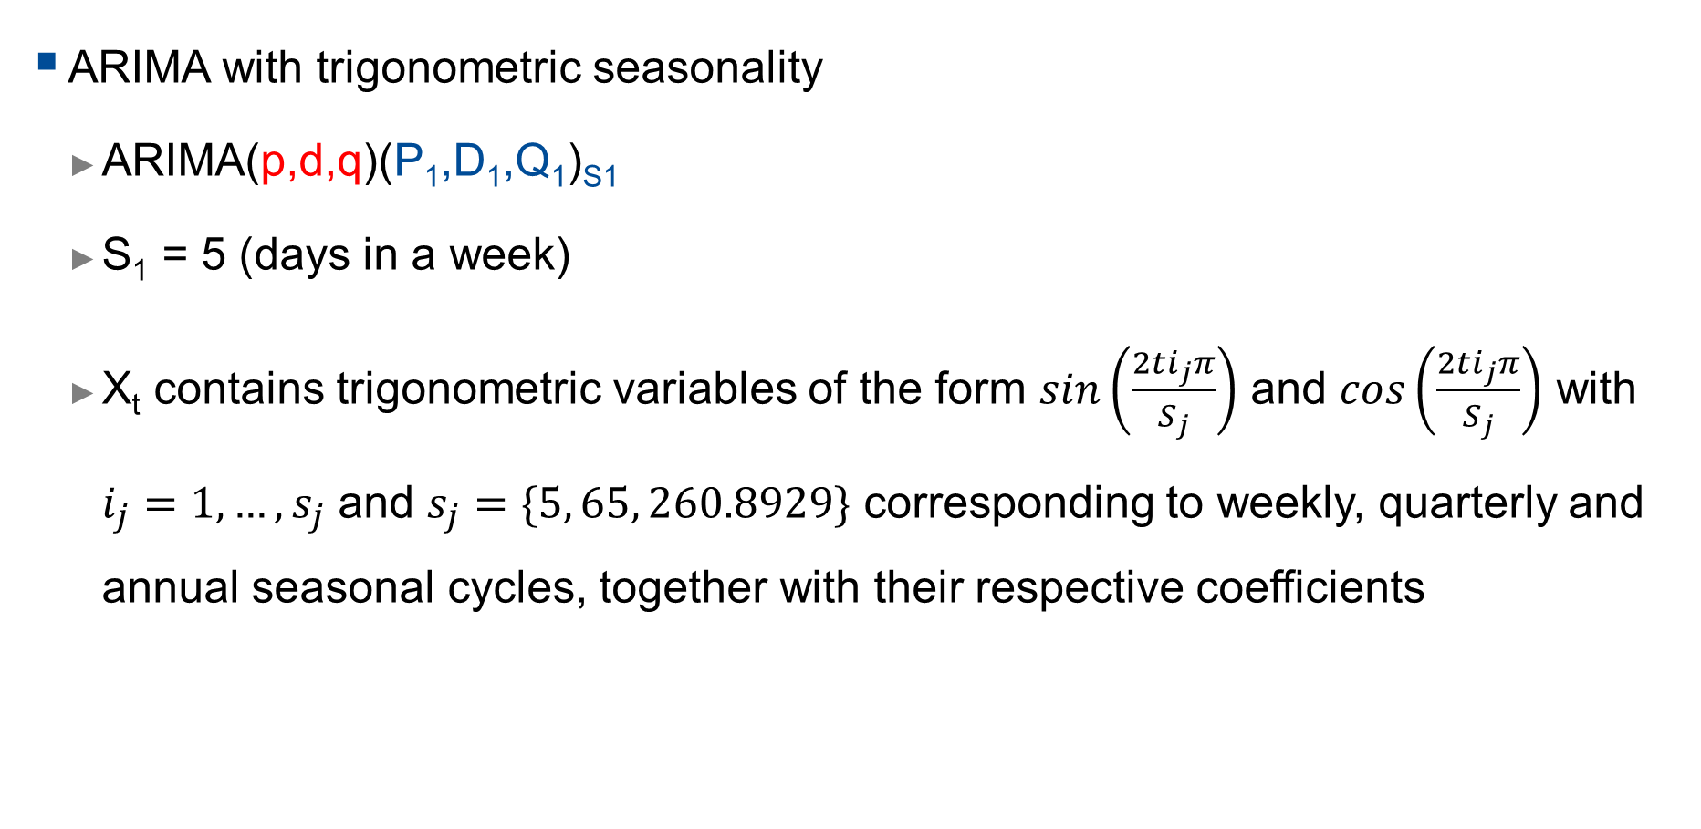
Advanced Models – ARIMA with Trigonometric Seasonality
ARIMA with trigonometric seasonality
ARIMA(p,d,q)(P₁,D₁,Q₁)_{S1}
S₁ = 5 (days in a week)
X_{t} contains trigonometric variables of the form $sin\left(\frac{2ti_{j}π}{S_{j}}\right)$ and $cos\left(\frac{2ti_{j}π}{S_{j}}\right)$ with $i_{j}=1, …, s_{j}$ and $s_{j}=\{5, 65, 260.8929\}$ corresponding to weekly, quarterly and annual seasonal cycles, together with their respective coefficients
$${\left(1−\sum_{i=1}^{p}{φ_{i}B^{i}}\right)\left(1−\sum_{k=1}^{P1}{{Φ1}_{k}B^{s1k}}\right)\left(1−B\right)}^{d}{\left(1−B^{s1}\right)}^{D1}Y_{t}=\left(1−\sum_{j=1}^{q}{θ_{j}B^{j}}\right)\left(1−\sum_{l=1}^{Q1}{{Θ1}_{l}B^{s1l}}\right)ε_{t}+Xt+D_{t}$$

Slide 44

Advanced Models – ARIMA with Trigonometric Seasonality
ARIMA with trigonometric seasonality
ARIMA trig A: first estimate coefficients of $X_{t}$ and $D_{t}$ and then estimate ARIMA part (it is a regARIMA model)
ARIMA trig B: jointly estimate all coefficients

Slide 45
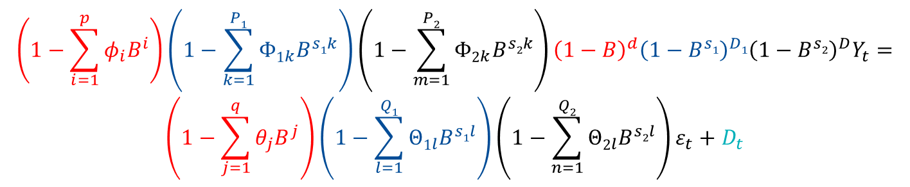
Advanced Models - ARIMA
ARIMA with multiple stochastic seasonality
ARIMA(p,d,q)(P₁,D₁,Q₁)_{S1}(P₂,D₂,Q₂)_{S2}
S₁ = 5 (days in a week)
S₂ = 5*13 (days in a quarter, 13 weeks)
$${\left(1−\sum_{i=1}^{p}{φ_{i}B^{i}}\right)\left(1−\sum_{k=1}^{P1}{{Φ1}_{k}B^{s1k}}\right)\left(1−\sum_{m=1}^{P2}{{Φ2}_{k}B^{s2k}}\right)\left(1−B\right)}^{d}{\left(1−B^{s1}\right)}^{D1}{\left(1−B^{s2}\right)}^{D}Y_{t}=$$
$$\left(1−\sum_{j=1}^{q}{θ_{j}B^{j}}\right)\left(1−\sum_{l=1}^{Q1}{{Θ1}_{l}B^{s1l}}\right)\left(1−\sum_{n=1}^{Q2}{{Θ2}_{l}B^{s2l}}\right)ε_{t}+D_{t}$$

Slide 46
Advanced Model: TBATS model
Combines in a single state-space model:
Exponential smoothing to model level and trend
Trigonometric terms to account for seasonality
Box-Cox transformation to account for non-normality
ARIMA errors to model the residuals dynamic
The TBATS model has appealing properties but, for some countries, tend to underperform simpler models (trigonometric ARIMA for instance). For some other countries, it performs very well

Slide 47
Models
Baseline Models
Moving average variance (presented in appendix)
Sophisticated Models
GARCH(1,1)
MIDAS with Hyperbolic Decay (not presented)
Fractionally Integrated GARCH (not presented)
Recommended Model
Restricted GARCH with fixed parameters
RiskMetrics or EWMA Variance
Common
All models use a moving average mean

Slide 48
Out-of-sample
All models evaluated out-of-sample
For implementation simplicity, only consider trading day samples
Naïve method perform best when using shorter window of 248 days
Average trading year based on data available
More sophisticated models make use of longer windows of 744 days (3 years)
All models recursively re-estimated using rolling windows
All forecasts genuinely out-of-sample
For comparison, first forecast is always in July 2017

Slide 49
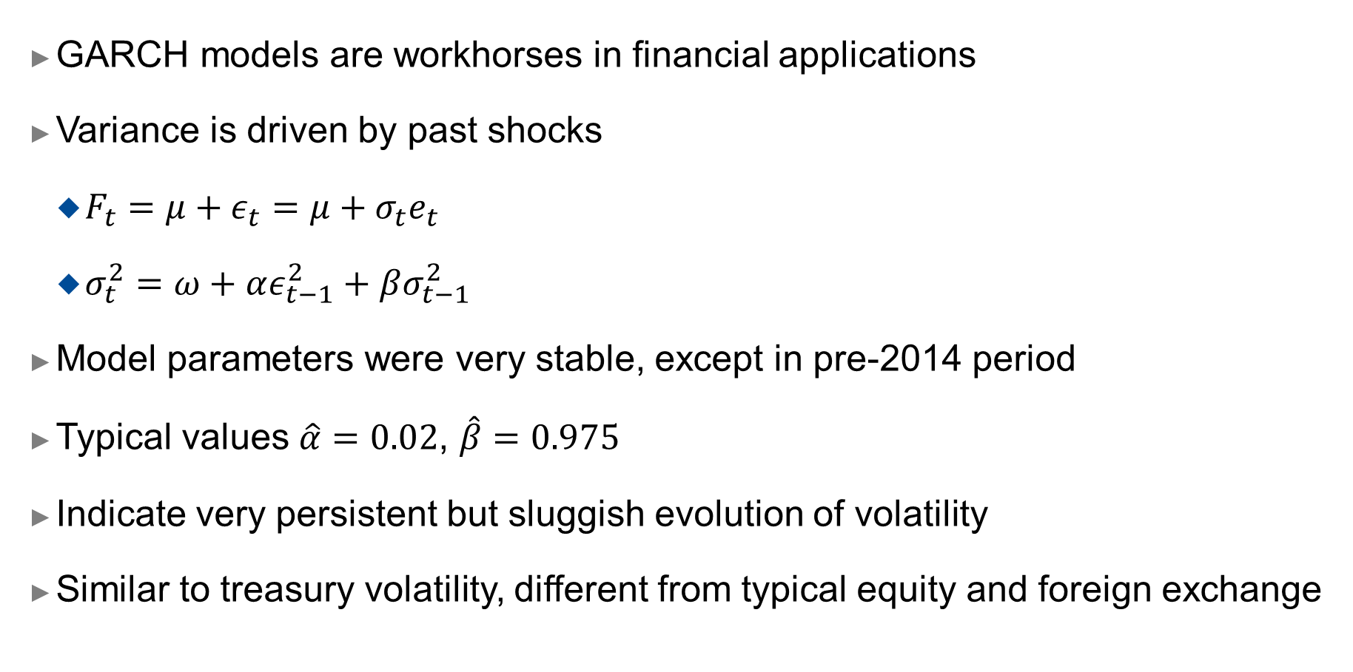
GARCH Models
GARCH models are workhorses in financial applications
Variance is driven by past shocks
$F_{t}=μ+ε_{t}=μ+σ_{t}e_{t}$
$σ_{t}^{2}=ω+αε_{t−1}^{2}+βσ_{t−1}^{2}$
Model parameters were very stable, except in pre-2014 period
Typical values $\hat{α}=0.02$, $\hat{β}=0.975$
Indicate very persistent but sluggish evolution of volatility
Similar to treasury volatility, different from typical equity and foreign exchange

Slide 50
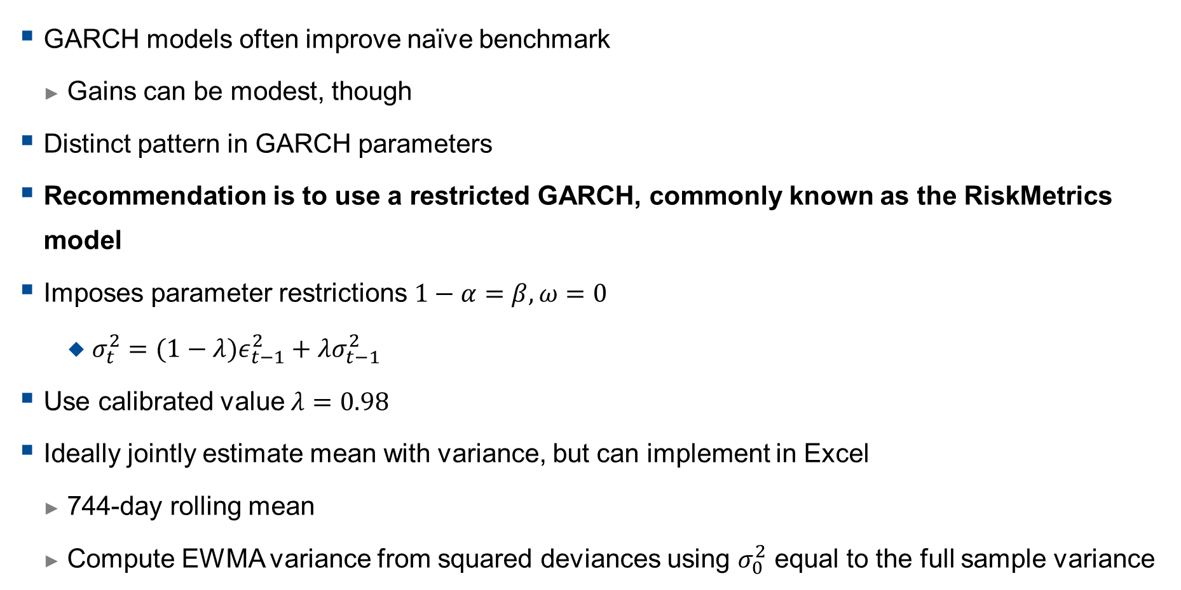
GARCH versus EWMA
GARCH models often improve naïve benchmark
Gains can be modest, though
Distinct pattern in GARCH parameters
Recommendation is to use a restricted GARCH, commonly known as the RiskMetrics model
Imposes parameter restrictions $1−α=β,ω=0$
$σ_{t}^{2}=(1−λ)ε_{t−1}^{2}+λσ_{t−1}^{2}$
Use calibrated value $λ=0.98$
Ideally jointly estimate mean with variance, but can implement in Excel
744-day rolling mean
Compute EWMA variance from squared deviances using $σ_{0}^{2}$ equal to the full sample variance

Slide 51
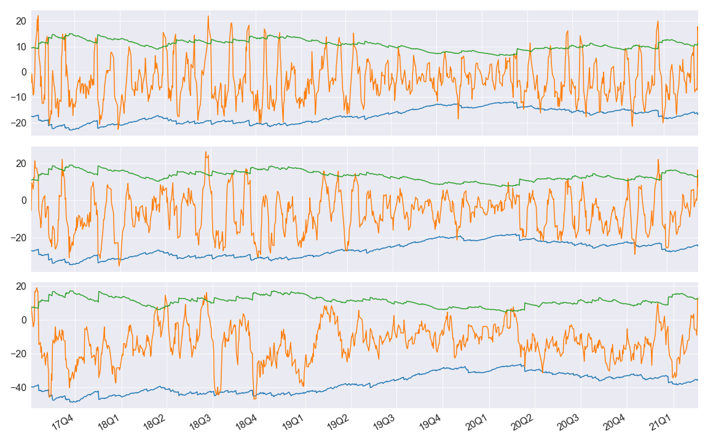
EWMA Model Performance (95%)

Slide 52
EWMA Model Performance
 | h=5 | h=10 | h=20
78 | 72.6 | 75.3 | 84.6
90 | 86.1 | 89.1 | 92.4
95 | 92.1 | 95.7 | 97.3
99 | 97.4 | 98.9 | 99.4
Improves coverage for lower quantiles
Improved coverage over GARCH in most cells

Slide 53
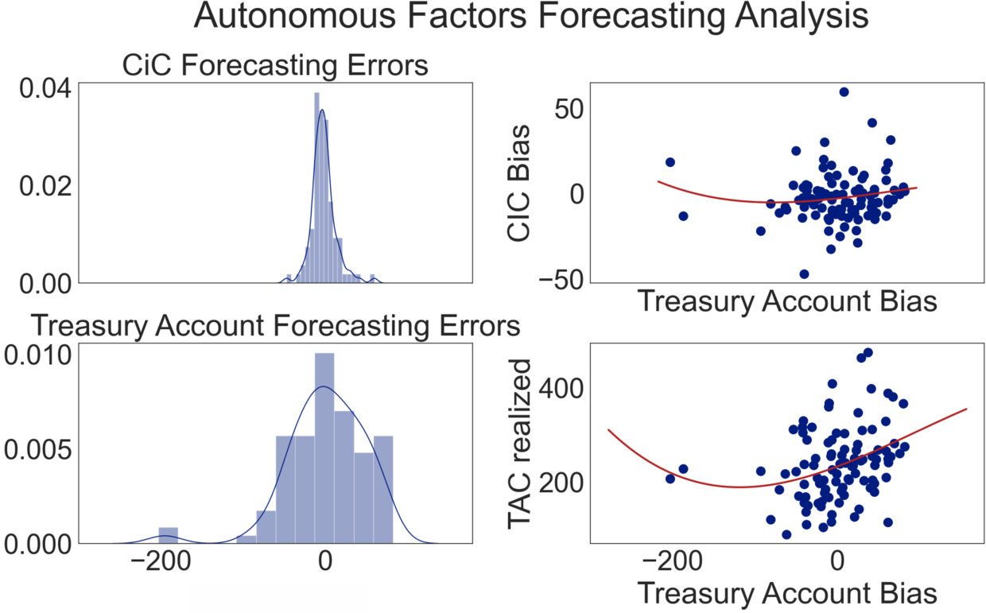

Slide 54
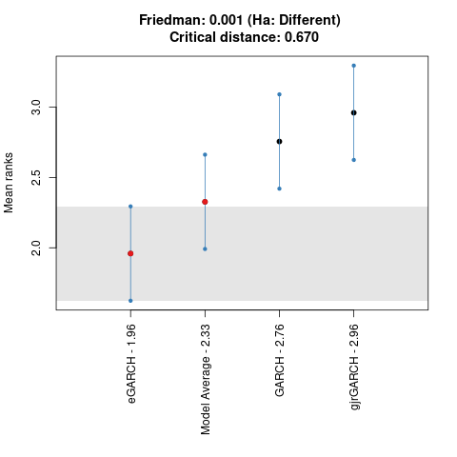
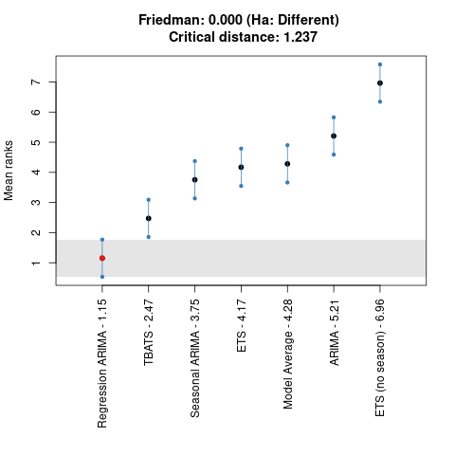
Nemenyi Plot (95% Winkler Score, 14-day ahead)

Slide 55
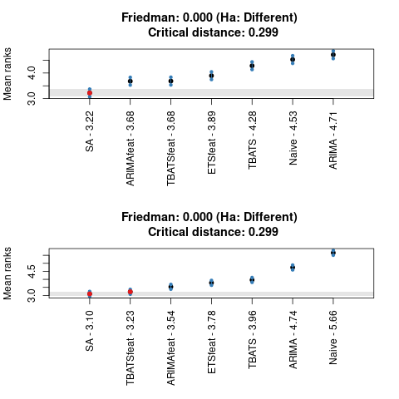
Example: State Account Forecasts Statistical Significance
When ranks are considered, Simple Average, significantly outperforms other models (mostly),
Top plot on right shows 5-day ahead forecasts,
Bottom plot on right shows 20-day ahead forecasts.

